Slide 1
JCI Heerenveen
Pubquiz

Slide 3
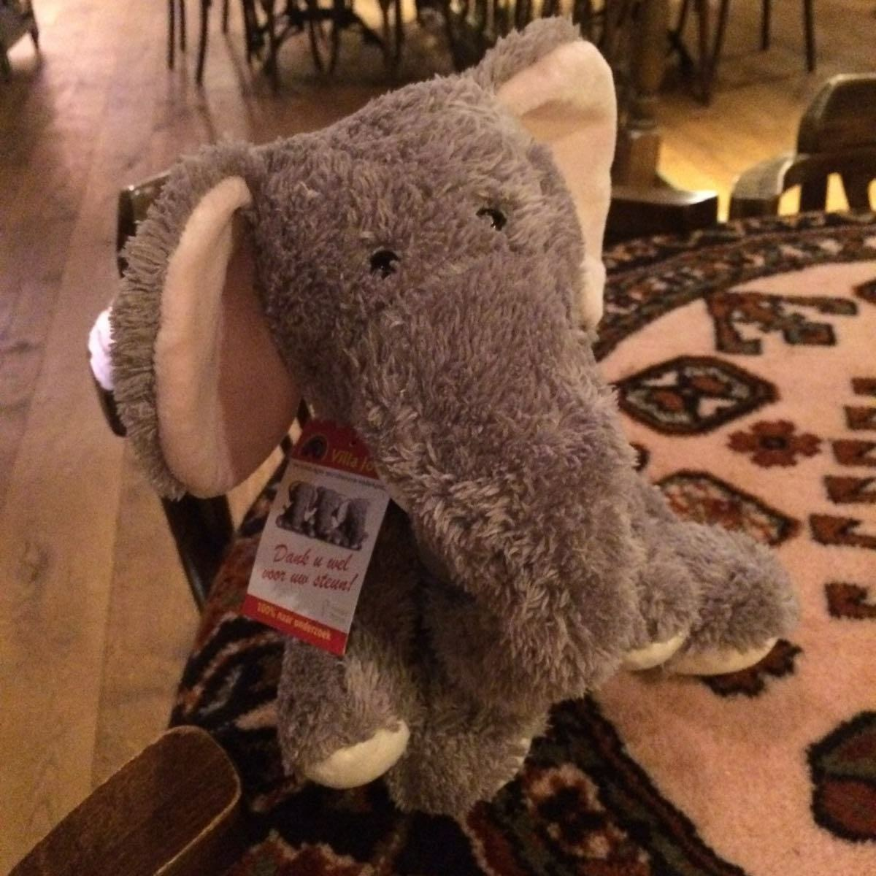

Slide 4
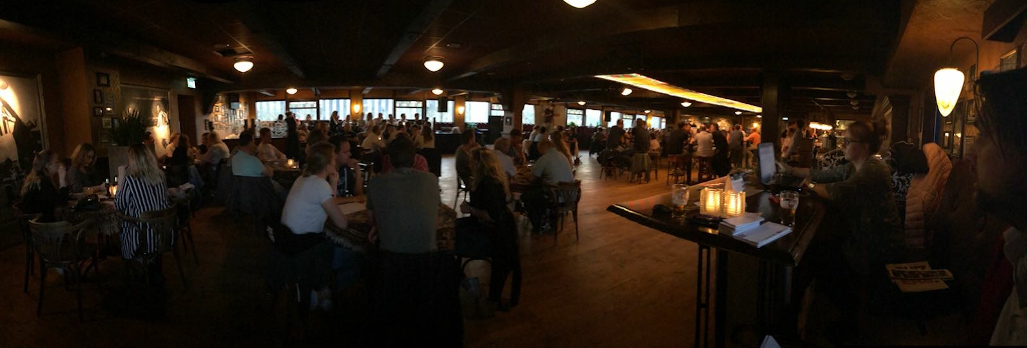

Slide 5
